Slide 1

Compiler Design Assignment 2
Iran University of Science & Technology
School of Computer Engineering
Spring 2021

Slide 2
Assignment Specifications
Subject: Introduction to Listener
Deadline: Monday, 25 Esfand, 23:59 (Would not be extended!!)
Where to upload: LMS
Your report should be provided continuing these slides
Full Name: AmirHossein Ahmadi
Student ID: 97522292

Slide 3
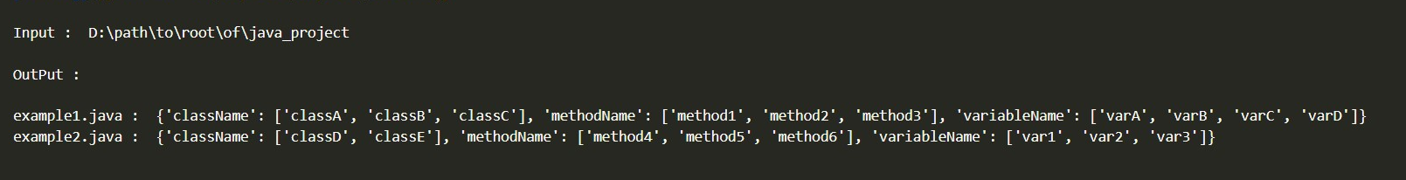
Assignment Details
Write a Python program using Listener to extract these from a Java project:
The names of all classes exist in each Java file.
The names of all methods exist in each Java file.
The names of all variables exist in each Java file
As sth like below:
Note: The output format can be different depends on your Java project. You might have different number of java files, classes, methods & variables.

Slide 4
Assignment Details (Continued)
2. Write a report of what you did .Test some examples on & use images to make your report more clear.
Good Luck!

Slide 5
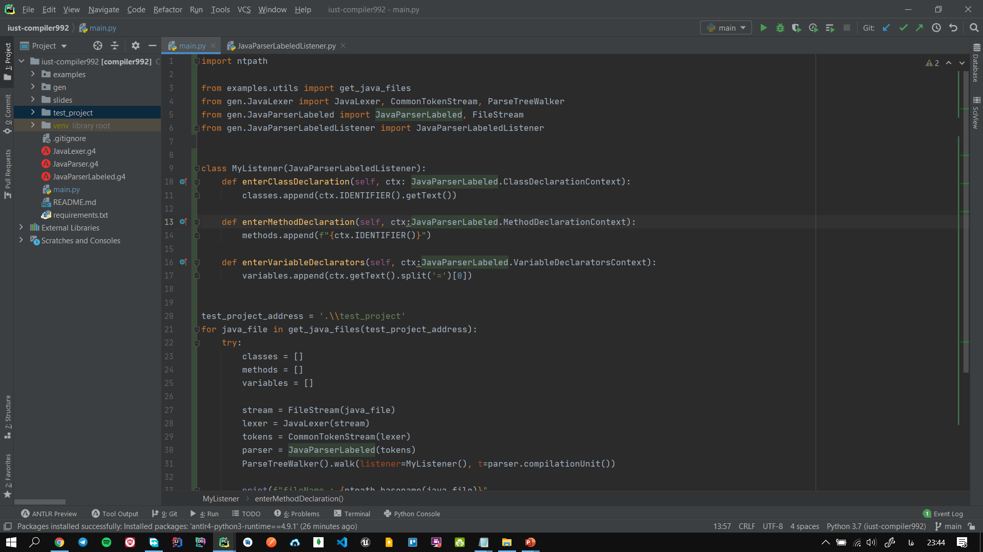
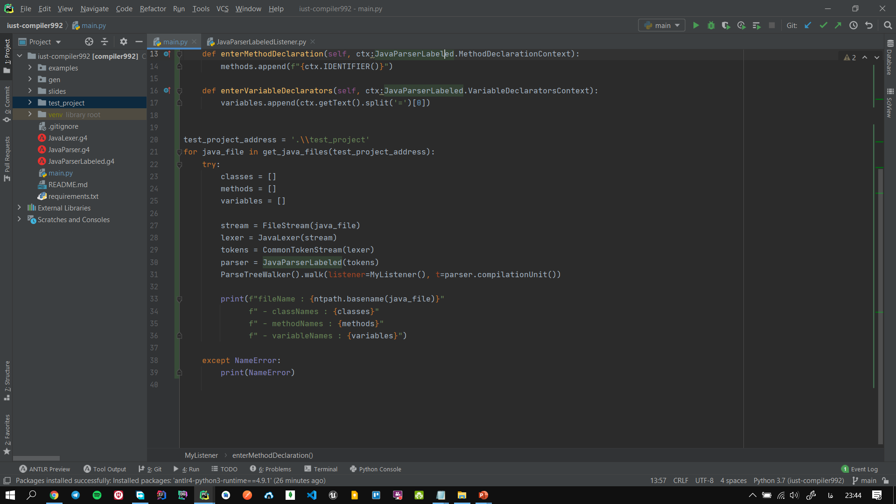
روند کار
ابتدا پروژه را کلن و requirement هایش را نصب کردم.
تابع های مورد نیاز در کلاس JavaParserLabeledListener را در MyListener پیاده سازی کردم.
به ازای همه ی فایل های جاوای موجود در فولدر test_project پارسر ساختم و به ParseTreeWalker دادم تا روی درخت آن پیمایش کند و با استفاده از MyListener آرایه های classes, methods, variables را پرکند و در آخر این آرایه ها را پرینت کردم.

Slide 6
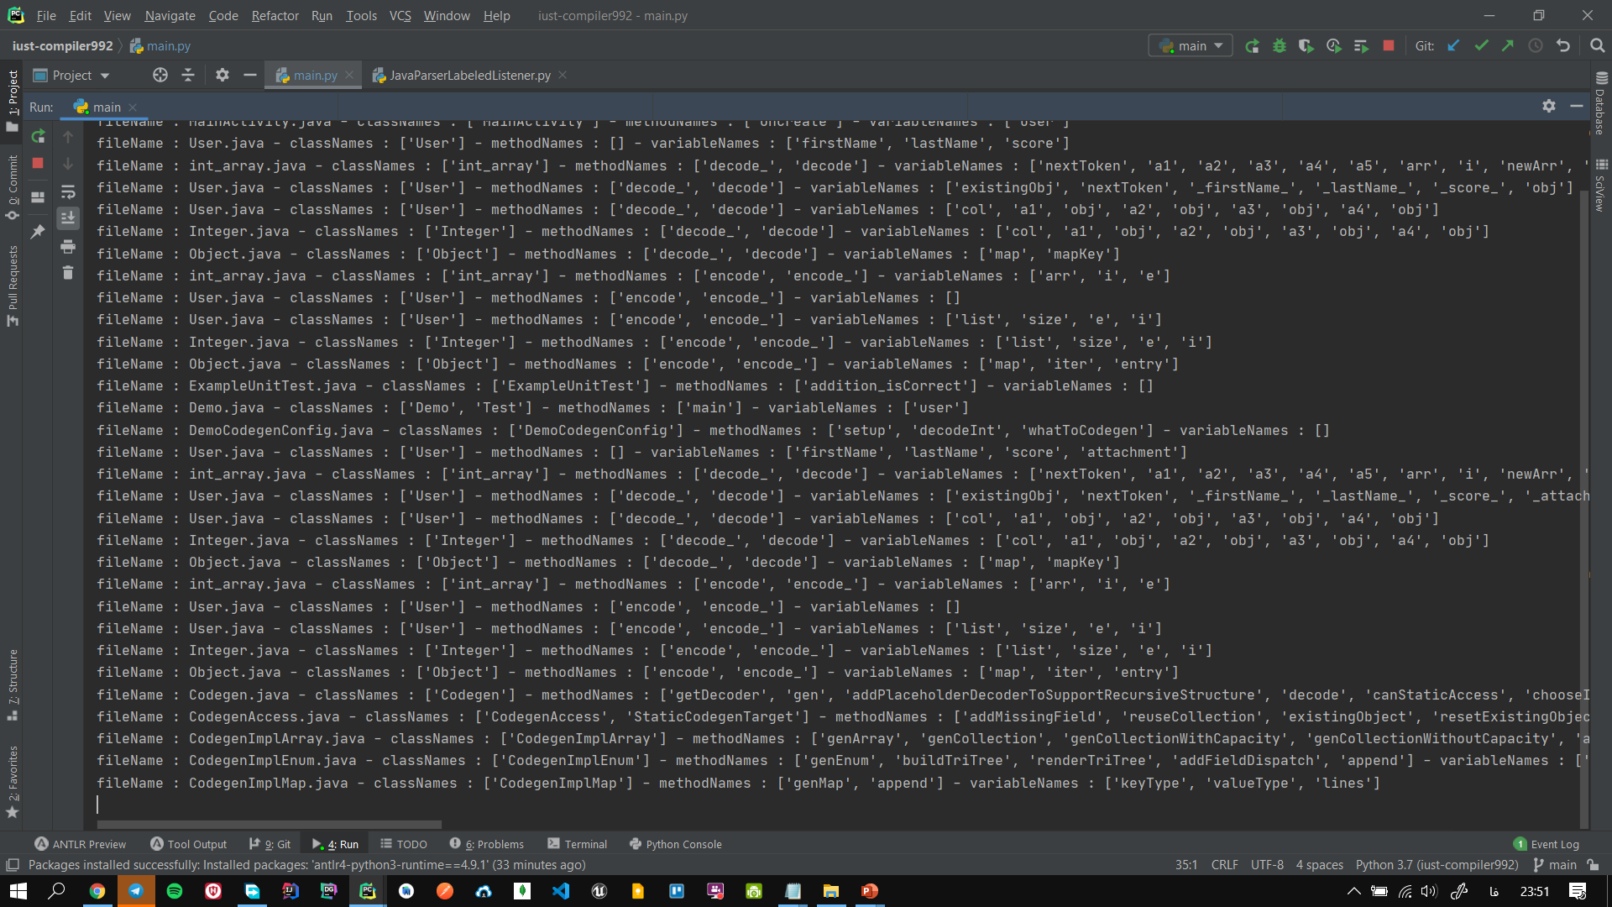
نتیجه:

